Slide 1
Diabetes Risk Prediction
Using Backpropagation

Slide 2
Dataset
Early-Stage Diabetes Risk Prediction Dataset
This dataset contains the sign and symptom data of newly diabetic or would be diabetic patient.
UCI Machine Learning Repository
Number of Instances: 520
Number of Attributes: 17

Slide 3
Attributes
16
INPUT VARIABLES
Age
Sex
Polyuria
Polydipsia
Sudden Weight Loss
Weakness
Polyphagia
Genital Thrush
Visual Blurring
Itching
Irritability
Delayed Healing
Partial Paresis
Muscle Stiffness
Alopecia
Obesity
01
OUTPUT VARIABLE
Class (Positive or Negative)

Slide 4
Model
50
Hidden Neurons
16
Input Neurons
01
Output Neuron

Slide 5
Training
520
Instances
6000
Repetitions

Slide 6
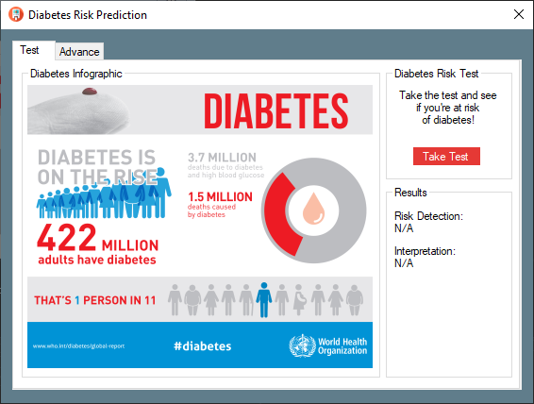
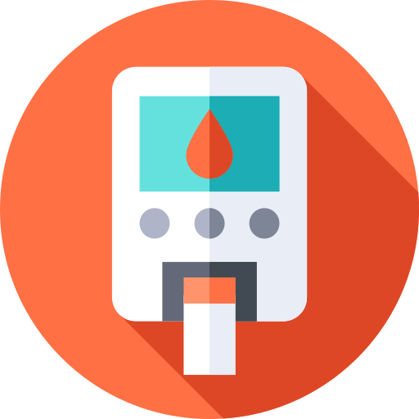
Demo

Slide 7
Results
520
Instances
97%
Training Accuracy
based on the training dataset.

Slide 8
End
Thank You!

